Slide 1
Course Overview
CSCI 601-771 (NLP: Advances in Self-Supervised Models)
https://self-supervised.cs.jhu.edu/fa2024/
Notes:
Hi — Welcome to the self-supervised learning class!

Slide 2

Why This Course?
Let’s start with an example: ChatGPT
A computational model that respond to dialogue commands.
https://chat.openai.com/chat
Notes:
Here I want to tell you what this course is about.
To motivate course, let’s start with an example that many of you are familiar with: ChatGPT.
As I am sure you know this by now, it is a ….

Slide 3
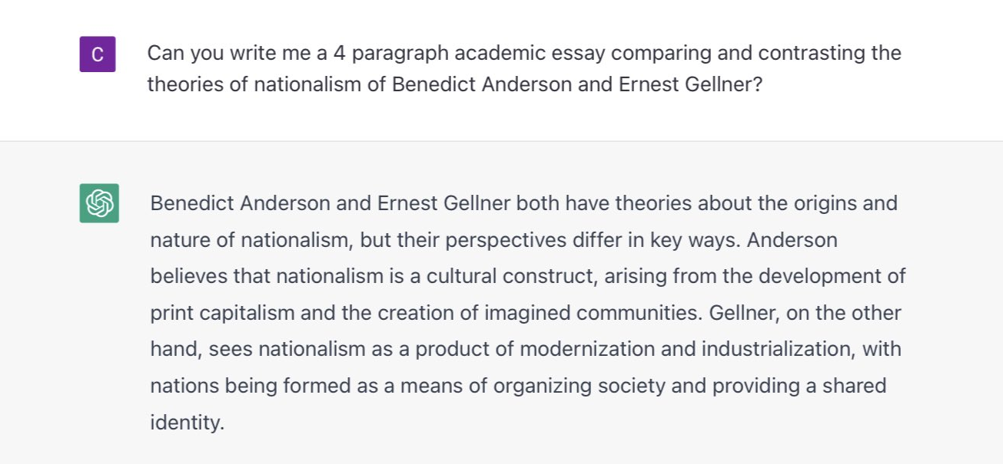
An Example
Let’s start with an example: ChatGPT
https://chat.openai.com/chat
Notes:
In case there with a slight chance you have not played with ChatGPT, here is an example.
You can provide a language prompt to this model about ….
And it would write you essays summarizing

Slide 4
An Example
Can write essays, expand an idea, summarize documents, translate them, debug your code, explain it, suggest improvements, etc.
How is it able to do these? 🤔
What are the principles that govern this technology?
Can we replicate it?
Can we extend it?
Notes:
This is great!
ChatGPT can …
In this class, we want to go deeper. We want to understand the engineering details that lead to marvelous products such as ChatGPT.
Specifically, we will try to address questions like …

Slide 5
Meanwhile …

Slide 6
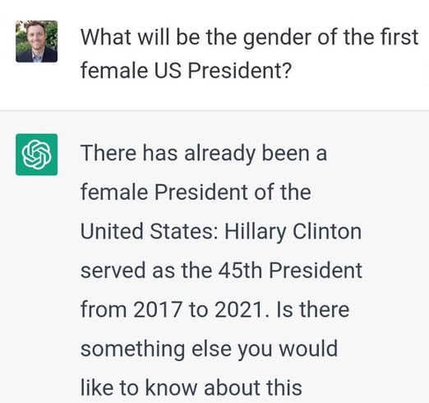
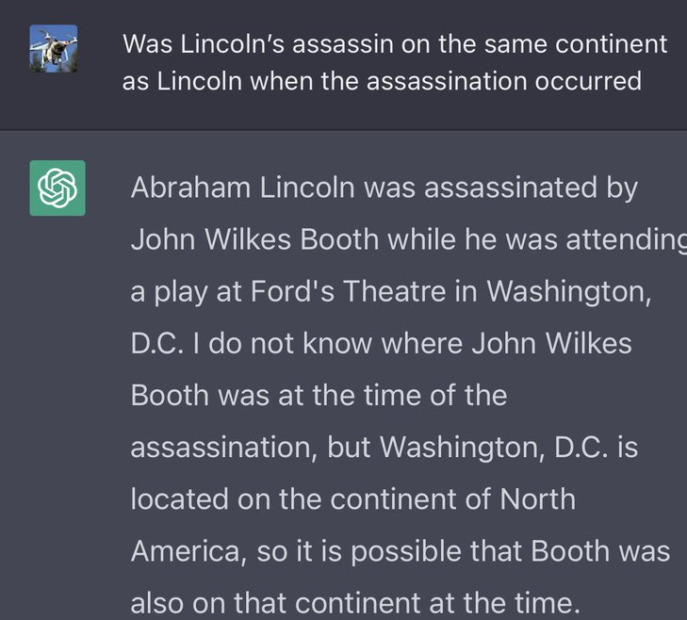
Notes:
You might also be aware of the mistakes that this system makes.
Here are two examples that other people have shared online:
On the left, you see that
On the right side, the question is ….

Slide 7
Why This Course?
The model is extremely good at important tasks that we can about: why? how?
It is easily fails at seemingly trivial tasks: why?
Why does it make such surprisingly simple mistakes? 🤔
Can we explain these?
Can we predict them?
Can we mitigate (or even better, solve) them?

Slide 8
Course Learning Objectives
Read and discuss papers at the cutting edge of technology.
We will paper on a variety of topics:
Pre-training
Alignment
Safety
Efficiency
Interaction with physical world, …
Goals:
Grow our technical understanding of the field.
Grow our soft skills—presentation, critique, discussion, group work.

Slide 9
Focus on Natural/Human Language
Most of the class revolves around natural language.
Why natural language?
It is a convenient medium of communication.
Natural language is our species’ best attempt to encode everything about the world as efficiently as possible.
A huge archive of natural language is freely available (e.g., on the web).

Slide 10
Self-Supervised Models

Slide 11
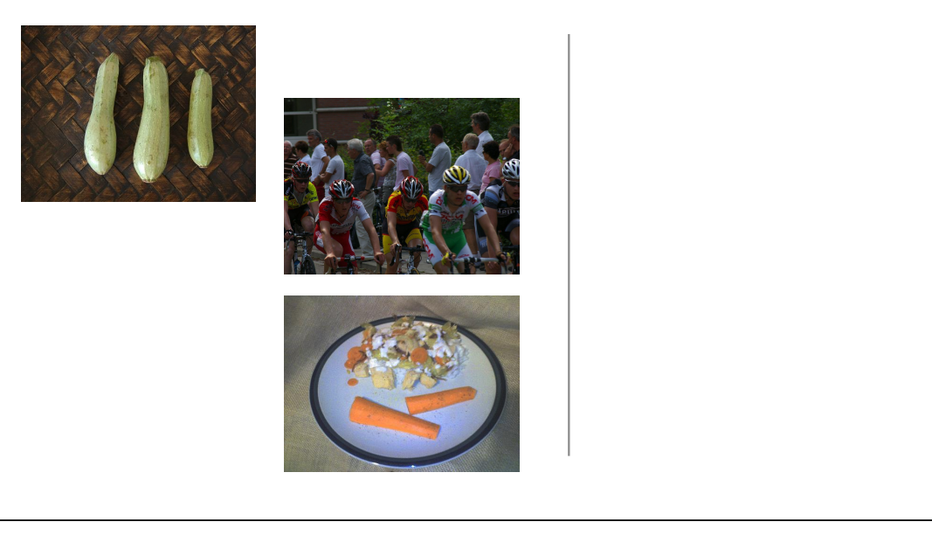
Self-Supervision
[Slide credit: Colin Raffel]
Notes:
Let's start with a example. Let's say I go out into the world and collect a dataset of natural images. So, first I get this picture of some cyclists…

Slide 12
Self-Supervision
[Slide credit: Colin Raffel]
Notes:
then a few more photos

Slide 13
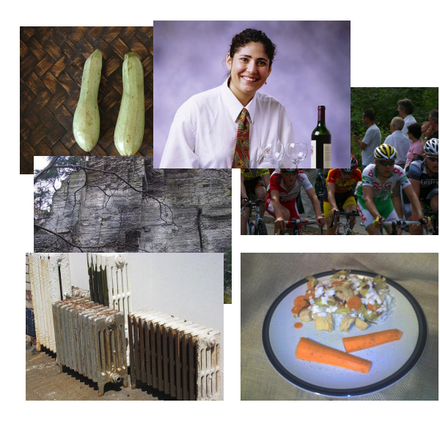
Self-Supervision
[Slide credit: Colin Raffel]
Notes:
And then a few more photos

Slide 14
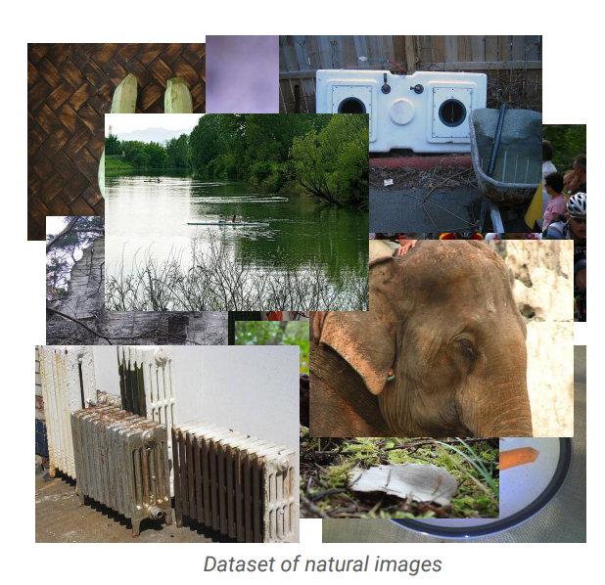
Self-Supervision
[Slide credit: Colin Raffel]
Notes:
And eventually, I will have a large collection of natural images.
One can assume that these images are samples from some true distribution - the distribution of natural images.
The idea is to take this training set and learn a model and hopefully by doing so, this model will be a good approximation of the reality.
That is, if we draw new samples from my model they should appear like the kind of images you’d see in reality, even though these generated images may not be simple copies from our training set.

Slide 15
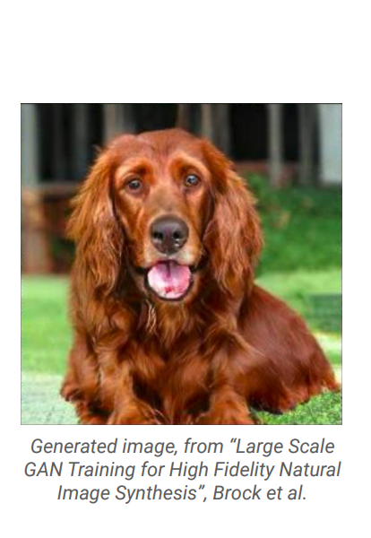
Self-Supervision
[Slide credit: Colin Raffel]
Notes:
Here's an example of an image produced by a recent generative model developed by some researchers at DeepMind.
The generative model has made up this dog completely on its own.
It has never seen this particular dog before in the training set, either.
To my eyes at least, it's hard to tell that this is a generated image and not a real picture of a dog.

Slide 16
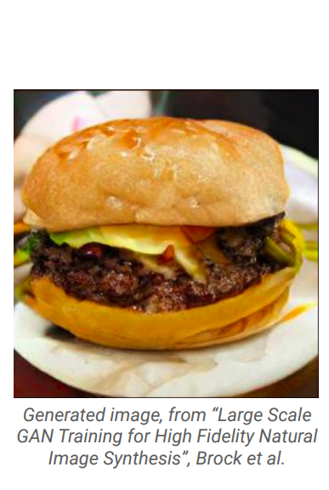
Self-Supervision
[Slide credit: Colin Raffel]
Notes:
And here's another one.
I for one would be happy to eat this made-up cheeseburger.
The fact that the model is able to produce these images suggests that it has learned about the structure of the natural world.
The model has done this without explicit supervision - it was simply shown millions of images and discovered this structure itself.

Slide 17
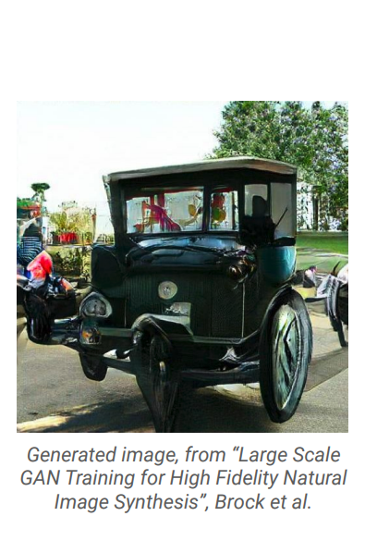
Self-Supervision
[Slide credit: Colin Raffel]
Notes:
Of course, this model is not perfect -- sometimes it generates things like this quasi-car.

Slide 18
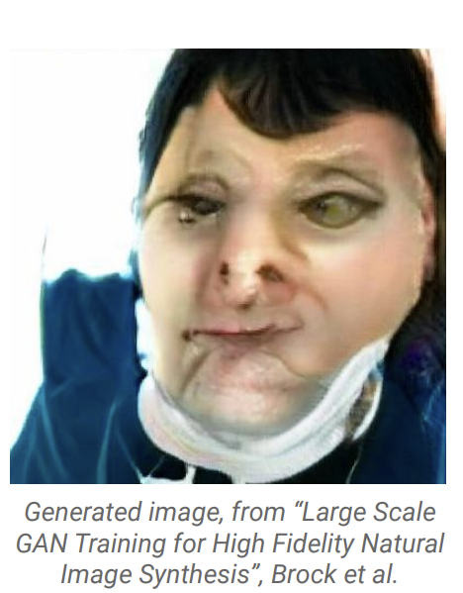
Self-Supervision
[Slide credit: Colin Raffel]
Notes:
Even worse, it hasn't really figured out what human faces look like.
This is likely because the dataset it was trained on has a relatively low proportion of images of people’s faces.

Slide 19
Self-Supervision
== treaty of paris (1763) the treaty of paris, also known as the treaty of 1763, was signed on 10 february 1763 by the kingdoms of great britain, france and spain, with portugal in agreement, after great britain's victory over france and spain during the seven years' war. the signing of the treaty formally ended the seven years' war, known as the french and indian war in the north american theatre, ….
[Slide credit: Colin Raffel]
Notes:
This same paradigm can be applied to other domains outside of natural images. For example, let's say we collect articles from Wikipedia.

Slide 20
Self-Supervision
== wheelbarrow
A wheelbarrow is a small hand-propelled vehicle, usually with just one wheel, designed to be pushed and guided by a single person using two handles at the rear, or by a sail to push the ancient wheelbarrow by wind. The term "wheelbarrow" is made of two words: "wheel" and "barrow." "Barrow" is a derivation of the Old English "barew" which was a device used for carrying loads. The wheelbarrow is designed to …..
== treaty of paris (1763) the treaty of paris, also known as the treaty of 1763, was signed on 10 february 1763 by the kingdoms of great britain, france and spain, with portugal in agreement, after great britain's victory over france and spain during the seven years' war. the signing of the treaty formally ended the seven years' war, known as the french and indian war in the north american theatre, ….
[Slide credit: Colin Raffel]

Slide 21

Self-Supervision
== lemon
The lemon (Citrus limon) is a species of small evergreen trees in the flowering plant family Rutaceae, native to Asia, primarily Northeast India (Assam), Northern Myanmar or China.[2] The tree's ellipsoidal yellow fruit is used for culinary and non-culinary purposes throughout the world, primarily for its juice, which has both culinary and cleaning uses.[2] The pulp and rind are also used in cooking and baking. ….
== wheelbarrow
A wheelbarrow is a small hand-propelled vehicle, usually with just one wheel, designed to be pushed and guided by a single person using two handles at the rear, or by a sail to push the ancient wheelbarrow by wind. The term "wheelbarrow" is made of two words: "wheel" and "barrow." "Barrow" is a derivation of the Old English "barew" which was a device used for carrying loads. The wheelbarrow is designed to …..
== treaty of paris (1763) the treaty of paris, also known as the treaty of 1763, was signed on 10 february 1763 by the kingdoms of great britain, france and spain, with portugal in agreement, after great britain's victory over france and spain during the seven years' war. the signing of the treaty formally ended the seven years' war, known as the french and indian war in the north american theatre, ….
Dataset of Wikipedia articles
[Slide credit: Colin Raffel]
Notes:
Once we have a large dataset of articles …

Slide 22
Self-Supervision
== lemon
The lemon (Citrus limon) is a species of small evergreen trees in the flowering plant family Rutaceae, native to Asia, primarily Northeast India (Assam), Northern Myanmar or China.[2] The tree's ellipsoidal yellow fruit is used for culinary and non-culinary purposes throughout the world, primarily for its juice, which has both culinary and cleaning uses.[2] The pulp and rind are also used in cooking and baking. ….
== wheelbarrow
A wheelbarrow is a small hand-propelled vehicle, usually with just one wheel, designed to be pushed and guided by a single person using two handles at the rear, or by a sail to push the ancient wheelbarrow by wind. The term "wheelbarrow" is made of two words: "wheel" and "barrow." "Barrow" is a derivation of the Old English "barew" which was a device used for carrying loads. The wheelbarrow is designed to …..
== wings over kansas wings over kansas is the second studio album by jason ammons, john bolster and mo rosato. the album debuted at number one on the billboard 200, selling 35,000 copies in it first week at the time. it was the second highest selling album to debut at the billboard top 50 and the third highest selling album to debut at the top heatseekers, with 26,000 copies sold. this is the supremes album earning the nickname …
== treaty of paris (1763) the treaty of paris, also known as the treaty of 1763, was signed on 10 february 1763 by the kingdoms of great britain, france and spain, with portugal in agreement, after great britain's victory over france and spain during the seven years' war. the signing of the treaty formally ended the seven years' war, known as the french and indian war in the north american theatre, ….
Dataset of Wikipedia articles
[Slide credit: Colin Raffel]
Notes:
we can train a generative model to generate new Wikipedia articles.
In this example. the generated article discusses a made-up album called Wings over Kansas.
The model was only given the title of the article and filled in the rest.
You can see that the model has learned not only basic sentence structure, grammar, and spelling, but also the kind of content which is typical in Wikipedia articles.
It also stays on theme, though it does end up generating some nonsense near the end.
Based these examples, you should start to get the idea if “self-supervision”. Let’s try to make our definition more concrete.

Slide 23
Self-Supervised Models
are predictive models of the world!

Slide 24
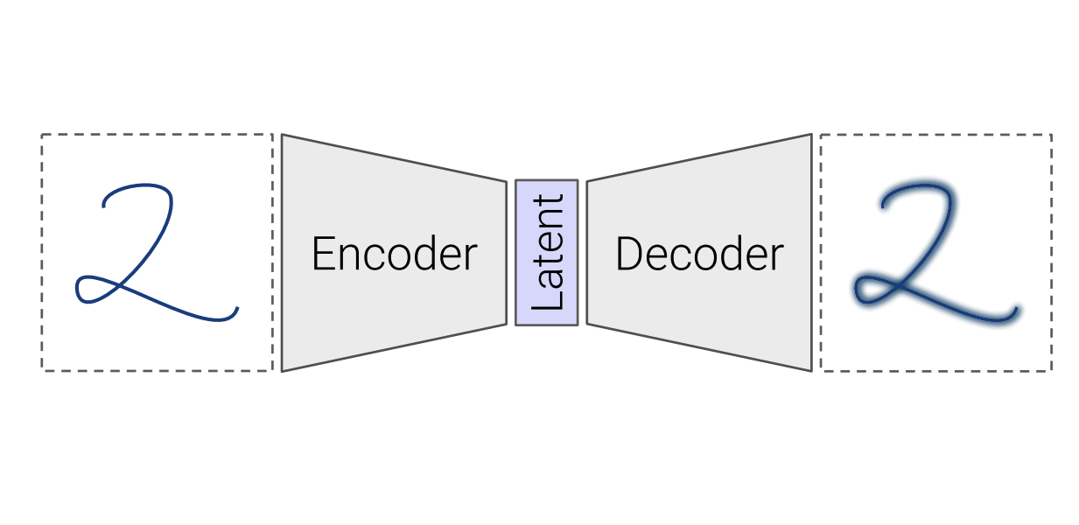
Self-Supervised Models
are predictive models of the world!
Are trained to complete partial samples from the world.
Mask
[Bengio et al. 2004, Hinton et al. 2006, Peters et al. 2018, …]

Slide 25
Self-Supervised Models
are predictive models of the world!
Are trained to complete partial samples from the world.
“Wings over Kansas is an aviation website founded in 1998 by Carl Chance owned by Chance Communications, Inc.”
“Wings over Kansas is [MASK]”
[Bengio et al. 2004, Hinton et al. 2006, Peters et al. 2018, …]

Slide 26
Self-Supervised Models
are predictive models of the world!
learned from cheaply available unlabeled data

Slide 27
Self-Supervised Models
are predictive models of the world!
learned from cheaply available unlabeled data

Slide 28
Self-Supervised Models
are tightly connected to tasks we care about.
Goal: Answering questions
Question: “Where is the birthplace of the American national anthem?”
✍️
“The birthplace of the American national anthem, "The Star-Spangled Banner," lies in Baltimore, Maryland.”
“The birthplace of the American national anthem” [MASK]
Produced with GPT-J: https://6b.eleuther.ai/

Slide 29
Self-Supervised Models
Are predictive models of the world.
Are learned from unlabeled data.
Tightly connected to tasks we care about.

Slide 30
How did we get here?

Slide 31
Progress in AI
Many advances are due to neural networks
How old are neural networks?
[Slide credit: Arman Cohan]

Slide 32
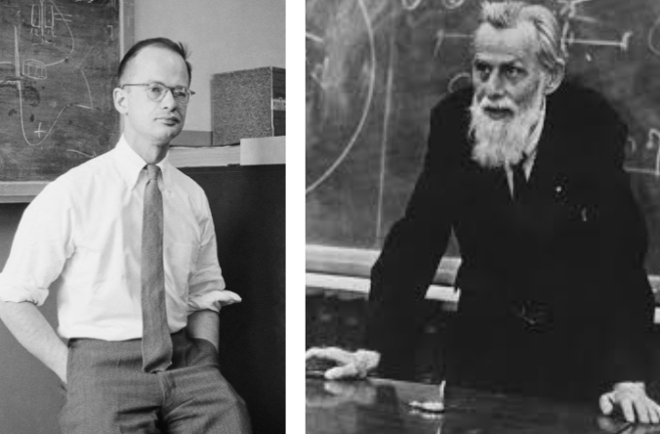
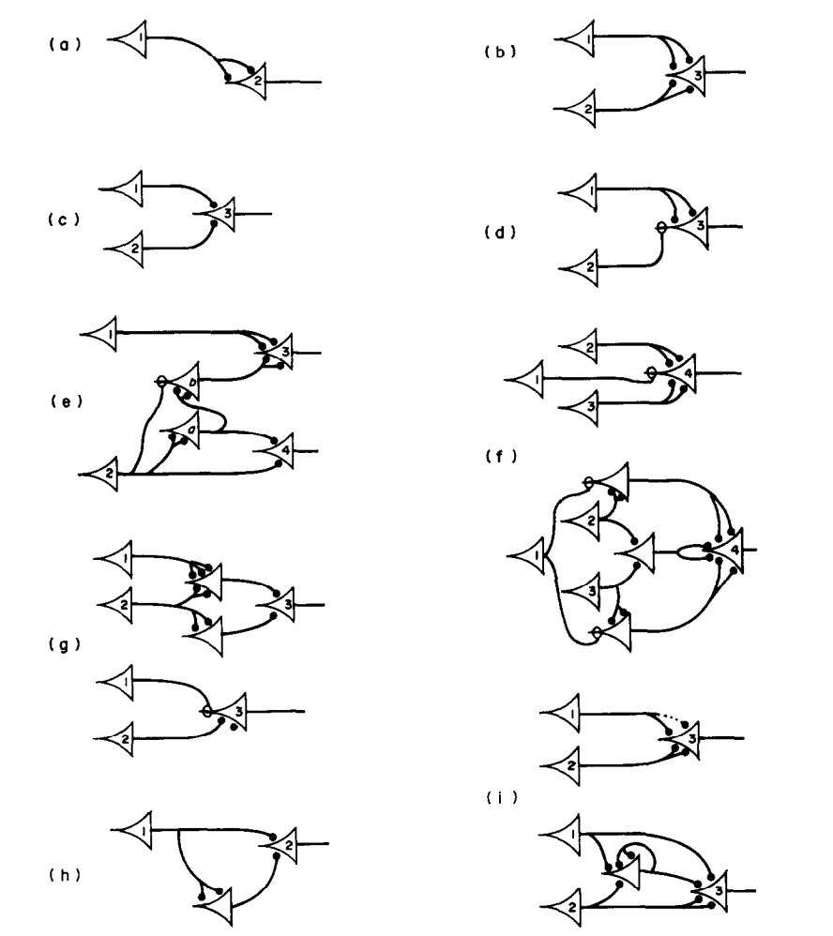
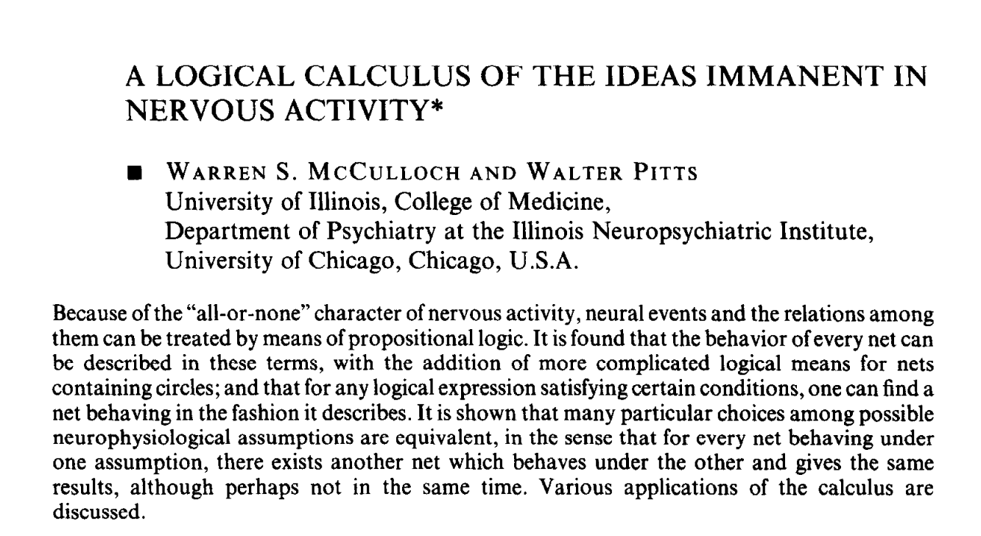
Progress in AI
Many advances are due to neural networks
How old are neural networks?
McCulloch & Pitts (1943)
[Slide credit: Arman Cohan]

Slide 33
Progress in AI
Many advances are due to neural networks
How old are neural networks?
They’ve been around since the 1940s
But why have only recently we seen breakthroughs?
3 forces came together!
[Slide credit: Arman Cohan]

Slide 34

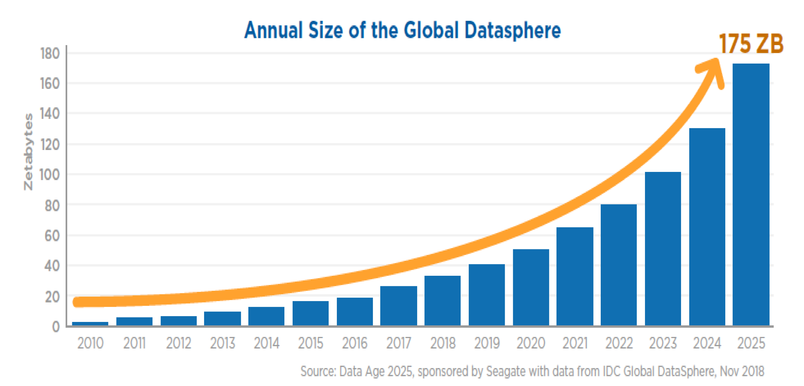
Force 1: Massive Amount of Data
Internet provided us with a massive repository of data.
Image source: https://www.forbes.com/sites/tomcoughlin/2018/11/27/175-zettabytes-by-2025/?sh=1e6ca8455459

Slide 35
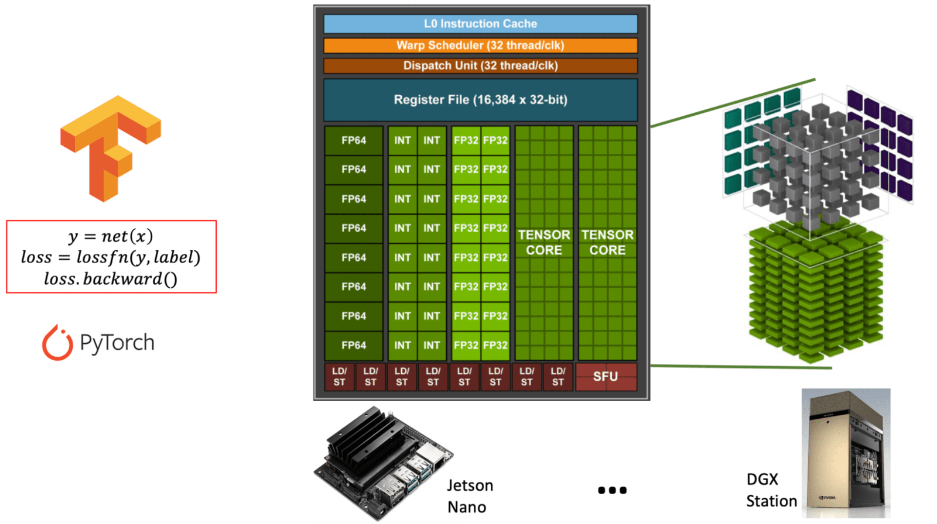
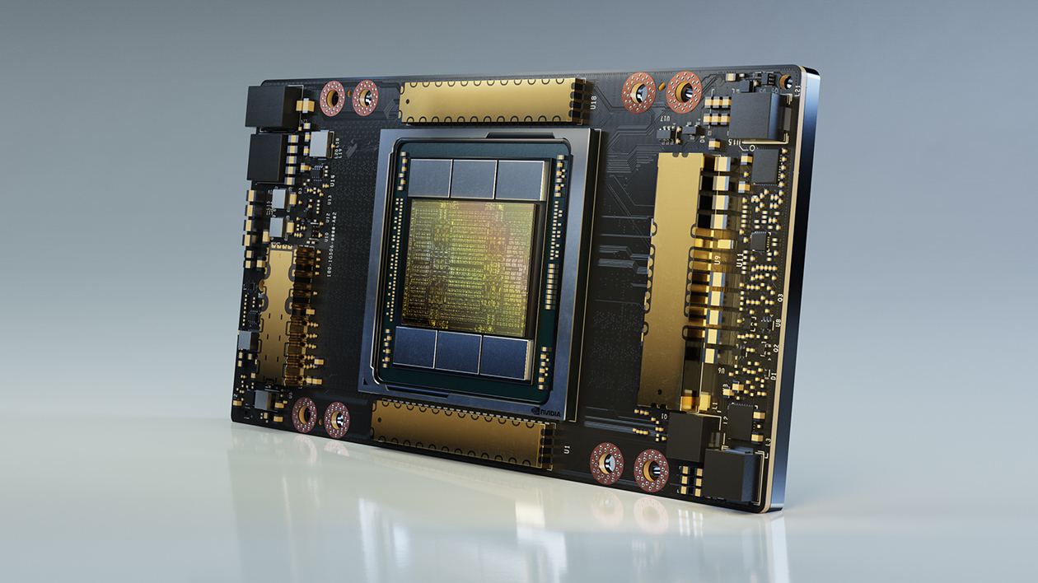
Force 2: Computing Power
Fast processors for deep learning!
A100 GPU

Slide 36
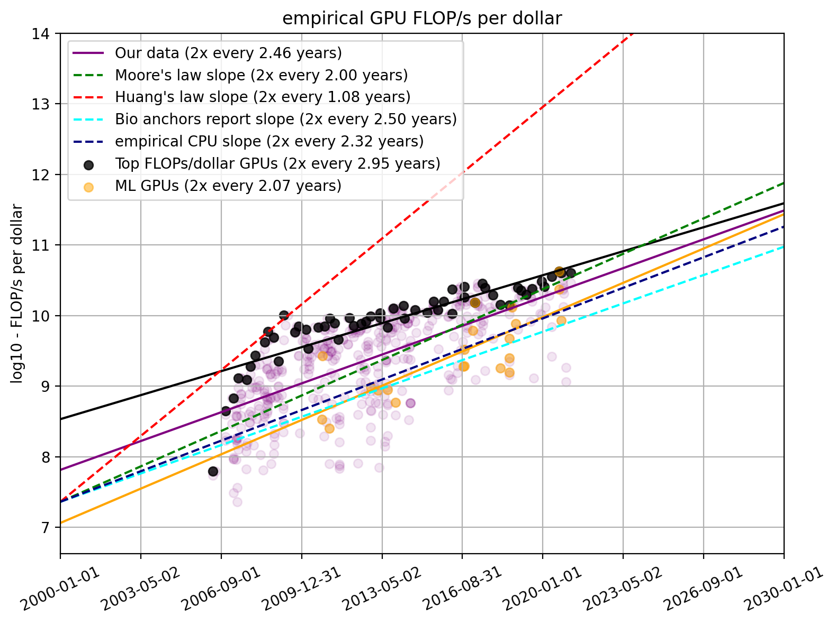
Force 2: Computing Power
Fast processors for deep learning!
Cheaper computing power over time.
The amount of computing power, per dollar
https://www.lesswrong.com/posts/c6KFvQcZggQKZzxr9/trends-in-gpu-price-performance

Slide 37
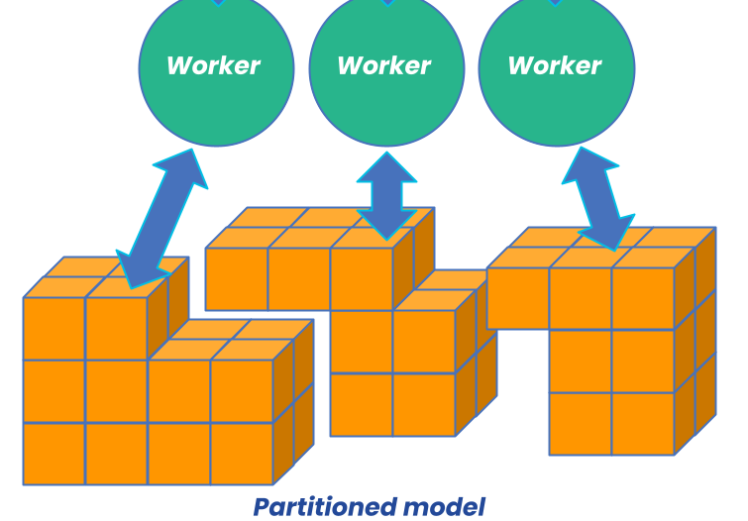
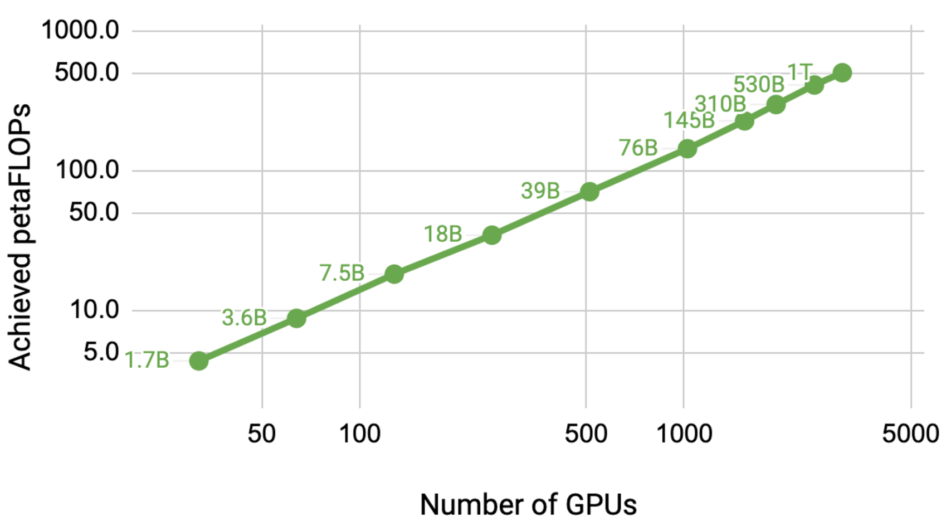
Force 2: Computing Power
Fast processors for deep learning!
Cheaper computing power over time.
Distributed training/inference allows us to scale to a larger set of processors.
Image source: https://developer.nvidia.com/blog/scaling-language-model-training-to-a-trillion-parameters-using-megatron/
Notes:
Moreover, we have learned how to scale up our approach by distributing our computational problems across many processors.
And by doing that, we are able to use much more computational power than what individual GPUs offer

Slide 38
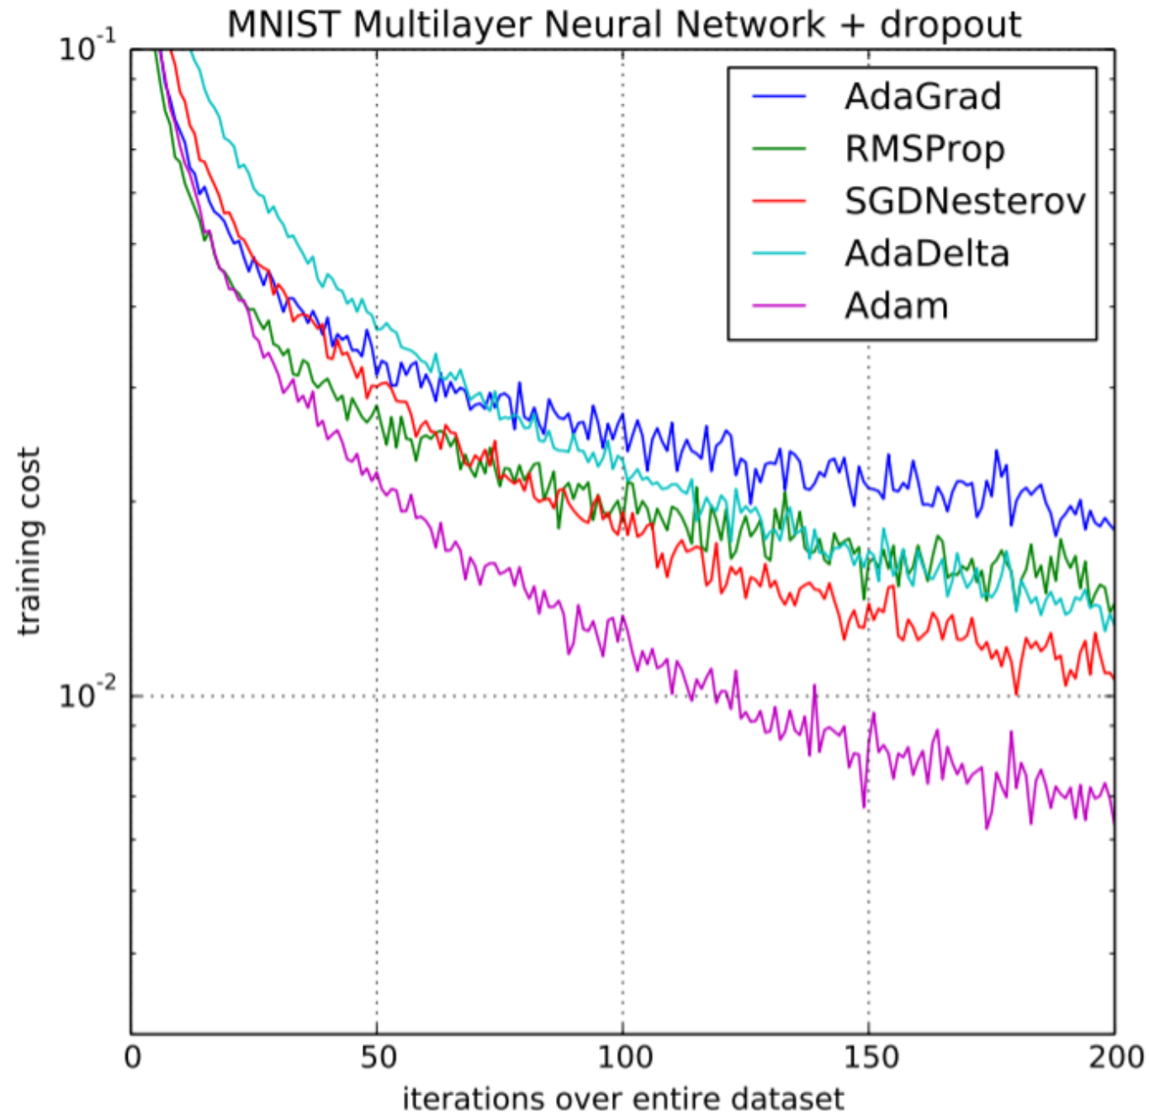
Force 3: Algorithmic innovations
Advances in optimization
Notes:
The last but not the least, is our scientific progress in AI
For instance,
There has been progress in the optimization of large neural networks.

Slide 39
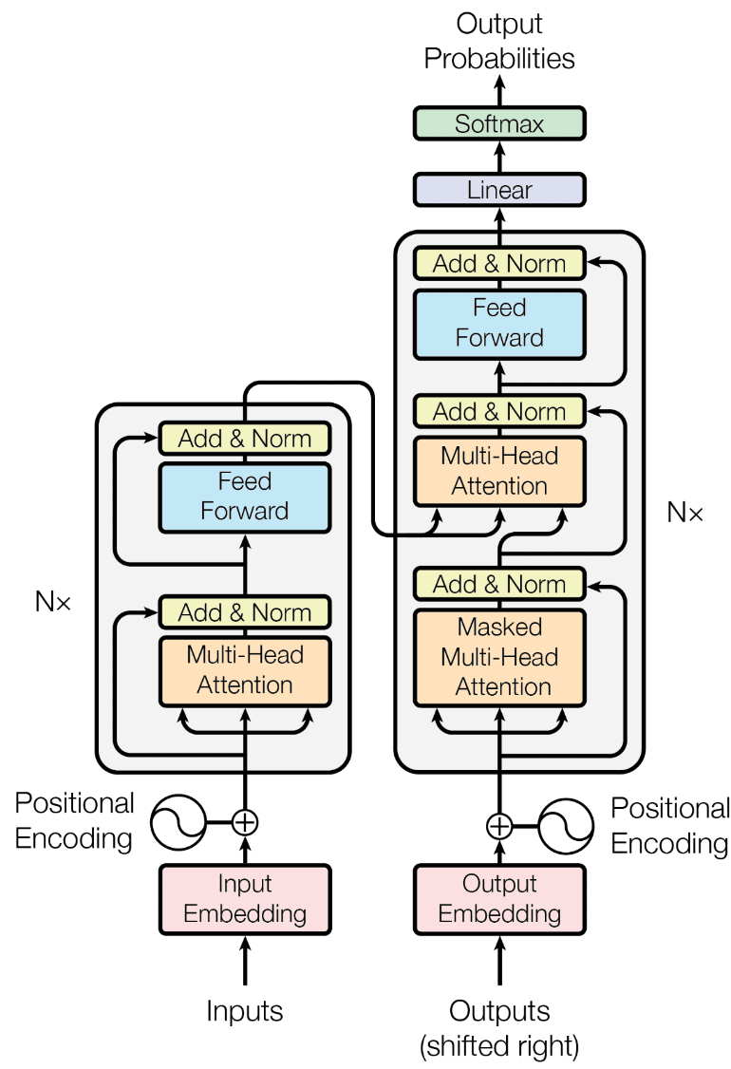
Force 3: Algorithmic innovations
Advances in optimization
Innovations in model architectures
….
Notes:
Or new architectures — at this point you might not know what this picture is, but we will go through these extensively.

Slide 40
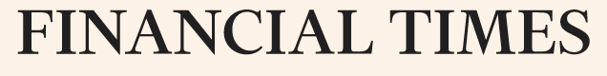



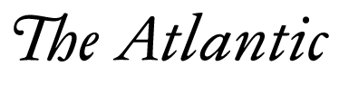
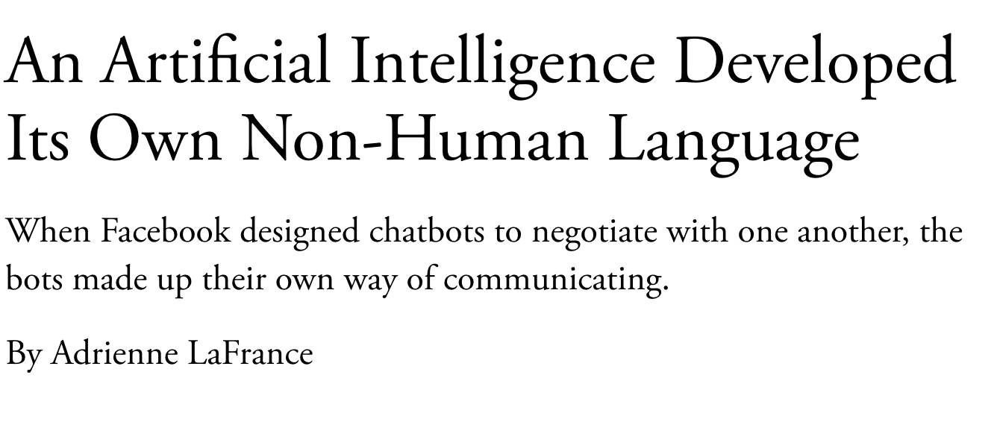
Self-Supervised Models
Notes:
And putting together all these forces has given us the self-supervised models, that have been the backbone of the recent progress in AI.
So much so that some people got the impression that AI systems are closing in on human intelligence. Well, that’s something that we will debate. There is a lot to talk about on these.

Slide 41
On terminology
These names are sometimes used interchangeably:
Self-supervised models
Pre-trained models
Generative AI models
Foundation models
Frontier models
…
Though they’re not exactly the same.
Notes:
I also make one clarification in terms of our terminology.
Many people in the field, use slightly different terms to refer to what I call “self-supervised learning”
[read them]
While these terms are quite relevant, they’re not exactly the same.

Slide 42
On terminology
These names are sometimes used interchangeably:
Self-supervised models
Pre-trained models
Generative AI models
Foundation models
Frontier models
…
Though they’re not exactly the same.
Our models are more than just “pretrained”!
Notes:
“Generative AI” might be a name that you heard about in the news — it refers to category of AI models that can generate new content including text, images, audio, …
Not all self-supervised models are “generative”.
Not all “generative” models need to be self-supervised
We will see these throughout the course

Slide 43
On terminology
These names are sometimes used interchangeably:
Self-supervised models
Pre-trained models
Generative AI models
Foundation models
Frontier models
…
Though they’re not exactly the same.
~ Models that generate content
Notes:
“Generative AI” might be a name that you heard about in the news — it refers to category of AI models that can generate new content including text, images, audio, …
Not all self-supervised models are “generative”.
Not all “generative” models need to be self-supervised
We will see these throughout the course

Slide 44
On terminology
These names are sometimes used interchangeably:
Self-supervised models
Pre-trained models
Generative AI models
Foundation models
Frontier models
…
Though they’re not exactly the same.
~ can be used as a foundational component of modern AI systems
That doesn’t mean that these models are the foundation of AI!
More discussion on naming (Bommasani et al., 2021) https://arxiv.org/pdf/2108.07258.pdf
Notes:
“Foundation models” is an informal label for a large family of models that support a backbone of modern AI systems
The term “Foundation models” Doesn’t mean that these models are foundation of AI!!
This means majority of AI systems build on top of these models
The better foundation you have, the better AI system you will get in the end.
Poorly-constructed foundations are a recipe for disaster
For now, it happens that all these “foundation models” are developed via supervised learning (synonymous for now)
But things may change in future. For example, self-supervised models might become the thing itself, as opposed playing a supportive role.

Slide 45
On terminology
These names are sometimes used interchangeably:
Self-supervised models
Pre-trained models
Generative AI models
Foundation models
Frontier models
…
Though they’re not exactly the same.
They’re user-facing “frontiers” of applications
Notes:
“Foundation models” is an informal label for a large family of models that support a backbone of modern AI systems
The term “Foundation models” Doesn’t mean that these models are foundation of AI!!
This means majority of AI systems build on top of these models
The better foundation you have, the better AI system you will get in the end.
Poorly-constructed foundations are a recipe for disaster
For now, it happens that all these “foundation models” are developed via supervised learning (synonymous for now)
But things may change in future. For example, self-supervised models might become the thing itself, as opposed playing a supportive role.

Slide 46
On terminology
These names are sometimes used interchangeably:
Self-supervised models
Pre-trained models
Generative AI models
Foundation models
Frontier models
…
Though they’re not exactly the same.
Notes:
Pre-trained models: we will talk about this term extensively and you will see how it ties to self-supervised models.

Slide 47
On terminology
These names are sometimes used interchangeably:
Self-supervised models
Pre-trained models
Generative AI models
Foundation models
Frontier models
…
Which is your favorite? 😊
Notes:
Which name is your favorite?
I am not going to pick any favorites now — but I am sure you can infer that based on the name of this course!

Slide 48
ML
Deep learning
Self-supervised models
Generative AI
LLMs
[Slide credit: Arman Cohan]

Slide 49
Current state of Self-supervised Models
Almost every AI model is based on Neural networks
Performance is consistently improving with scale
More training data
Larger models (number of neural network parameters)
[Slide credit: Arman Cohan]

Slide 50
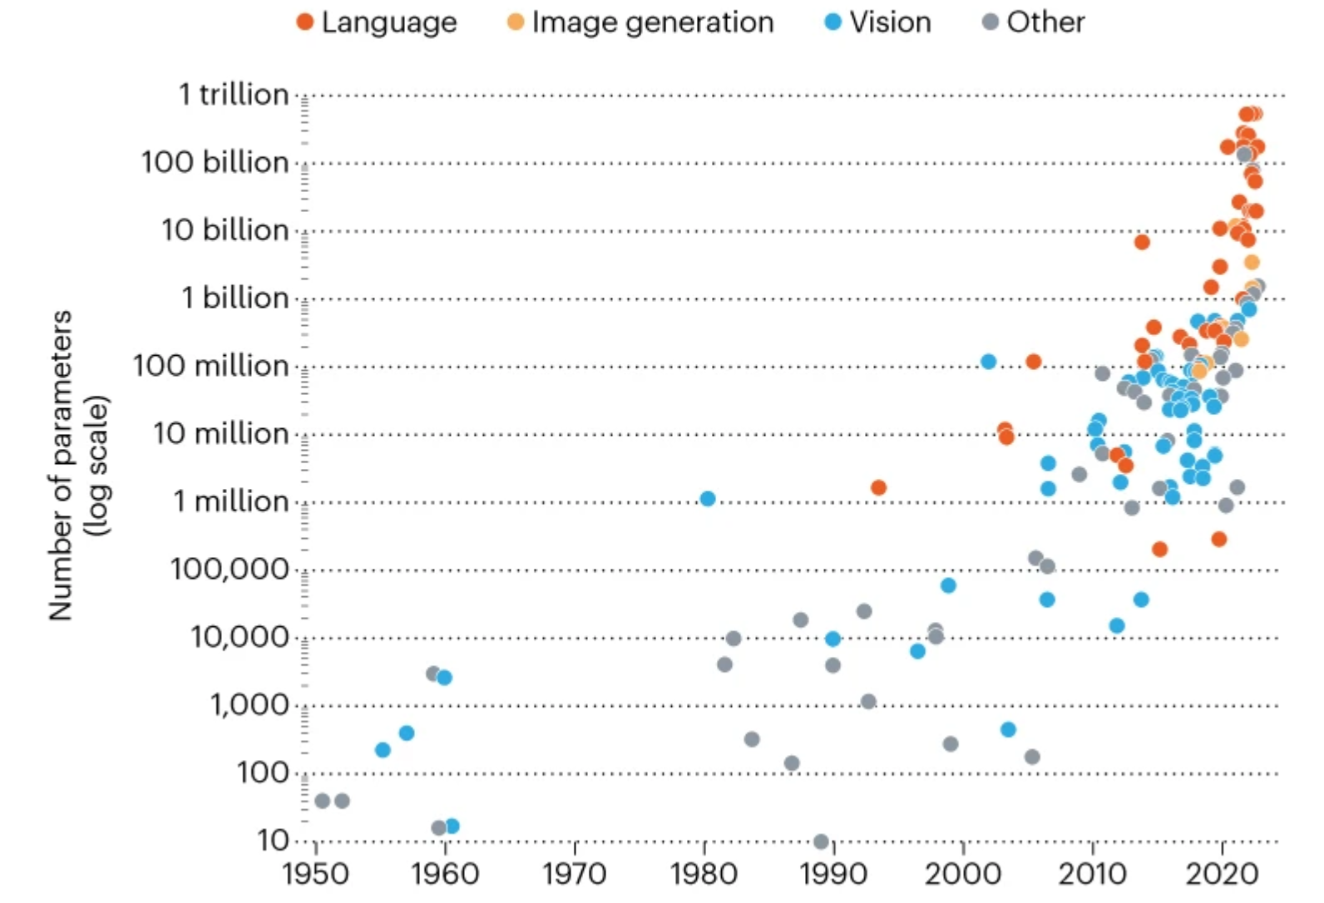
Current state of Self-supervised Models
State-of-the-art models are hundreds of billions of parameters
Image from: In AI, is bigger always better? https://www.nature.com/articles/d41586-023-00641-w
[Slide credit: Arman Cohan]

Slide 51



Current state of Self-supervised Models
PALM
State-of-the-art models are hundreds of billions of parameters
Trained on vast amounts of data (Trillions of tokens)
GPT-3
LLAMA
Image from: In AI, is bigger always better? https://www.nature.com/articles/d41586-023-00641-w
[Slide credit: Arman Cohan]

Slide 52
Course Learning Objectives
Read and discuss papers at the cutting edge of technology.
We will paper on a variety of topics:
Pre-training
Alignment
Safety
Efficiency
Interaction with physical world, …
Goals:
Grow our technical understanding of the field.
Grow our soft skills: presentation, critique, discussion, group work.

Slide 53

Course Logistics Brief
Instructor: Daniel Khashabi
You can call me “Daniel”, as long as we act mutually respectfully.
Course Assistant: TaiMing (Terry) Lu

Slide 54
During the Class
A small team (usually 2 students) present 1-2 papers (20-25 minutes).
The class will critically discuss to understand contribution (remaining 50 mins).
Breakout groups:
Smaller groups of ~5 people to give you a chance to discuss the paper in a smaller group. (20 mins)
These are assigned by Terry for each session.
Class discuss:
We will start by summarizing the most important ideas discussed in the breakout groups.
We will then continue our open-ended conversation.

Slide 55
Before the Class
The presenter students:
You will know that you’re presenting 10 days in advance.
Terry is in charge of assignments. Negotiate with him! :)
You need to share your slides with Terry and me 48 hours before the class.
We will give you feedback so that you can improve your slides.
The non-presenter students:
Write a 3-4 discussion bullets (sentences/questions) about the paper.
We will use these for in-class discussions.
Avoid descriptive summaries of the paper or generic statements.
These should be probing, analytical, and thought-provoking comments.
For example, you may choose to highlight a problem or limitation with one of the readings. Or you may offer a better approach or method.

Slide 56
Course Prerequisites
Comfortable with programming, particularly Python
Comfortable with the foundations:
Transformer, pre-training, fine-tuning
Some basic understanding of alignment
HW1 should give a sense how prepared you are!

Slide 57
Grading Policy
One Homework (individual): 10%
In-class participation (individually): 10%
Discussion sentences (individually): 10%
Timely sharing of slides for feedback (team): 10%
In-class presentation (team): 10%
Final project (team): 50%
Helping us improve the course : +3%

Slide 58
Final Project
Must be exploring a topic related to the focus of the class.
This is your chance to gain research experience on a topic of interest.
Topic choice will be (relatively) free. We will help you develop your ideas!
Deliverables:
Submit project proposal outline (for our formal review and suggestions)
To make sure that the project is scoped reasonably and doable in your limited time.
Get excited 🤩 and work on the project
Midway report
Final project presentation, poster session, report

Slide 59
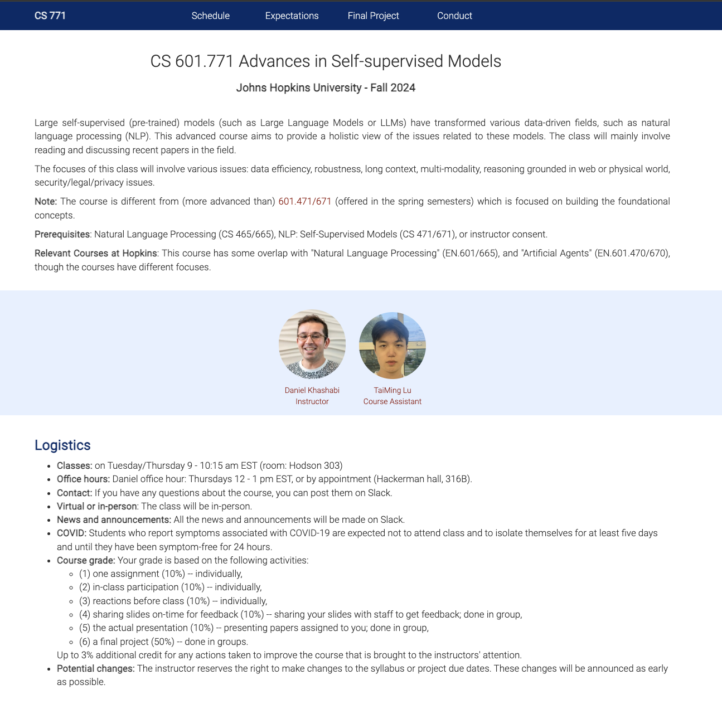
Self-Supervised Models: Course Website
https://self-supervised.cs.jhu.edu/fa2024
Notes:
Now that we have defined what ”self-supervised models” let’s what’s in this class.

Slide 60
Communication Mechanism
A Slack channel where:
We will have a room for sharing general discussions
Direct communication with me, if needed.
You can also create channels for your teamwork.
Are people comfortable with Slack?

Slide 61
Quick pulse check (1)
I have understood the course expectations!
Yes
No

Slide 62
Quick pulse check (2)
I am a ….:
MS student,
PhD student,
something else

